Slide 1
POLYMERS
Polymerization

Slide 3
Polymerization
Polymerization is chemical a process of reacting monomer molecules together in a chemical reaction to form linear chains or a three-dimensional network of polymer chains. There are many forms of polymerization and different systems exist to categorize them.
The main categories are:-
  Addition polymerization
  Step polymerization
Terminology in the literature to represent these types of polymerizations is not standard: there are multiple terms for the same type. For example, "step polymerization" and "step-growth polymerization" refer to the same type of polymerization.

Slide 5
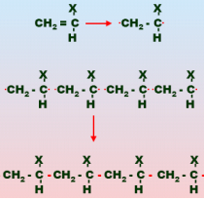
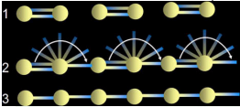
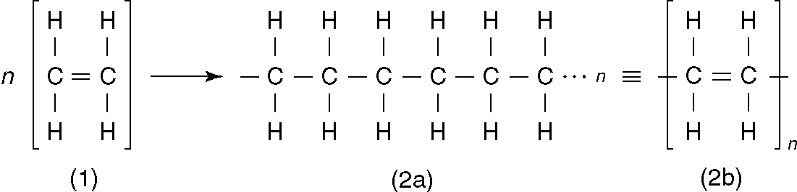
Addition Polymerization Or chain Growth Polymerization
In this process, for example the polyethylene, the double bonds between carbon atoms in the ethylene monomers are induced to open up so that they join with other monomer molecules
The connections occur on both ends of the expanding macromolecule, developing long chains of repeating mers
It is initiated using a chemical catalyst (called an initiator) to open the carbon double bond in some of the monomers

Slide 6
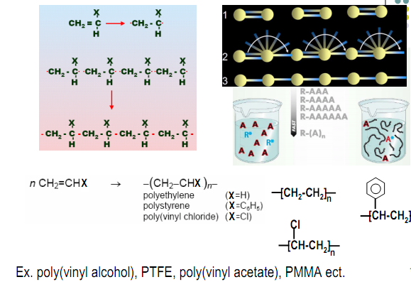
Figure above ‑ Model of addition (chain) polymerization: (1) initiation, (2) rapid addition of monomers, and (3) resulting long chain polymer molecule with n mers at termination of reaction

Slide 7
Step Polymerization
In this form of polymerization, two reacting monomers are brought together to form a new molecule of the desired compound
As reaction continues, more reactant molecules combine with the molecules first synthesized to form polymers of length n = 2, then polymers of length n = 3, and so on
In addition, polymers of length n₁ and n₂ also combine to form molecules of length n = n₁ + n₂, so that two types of reactions are proceeding in the same time

Slide 8
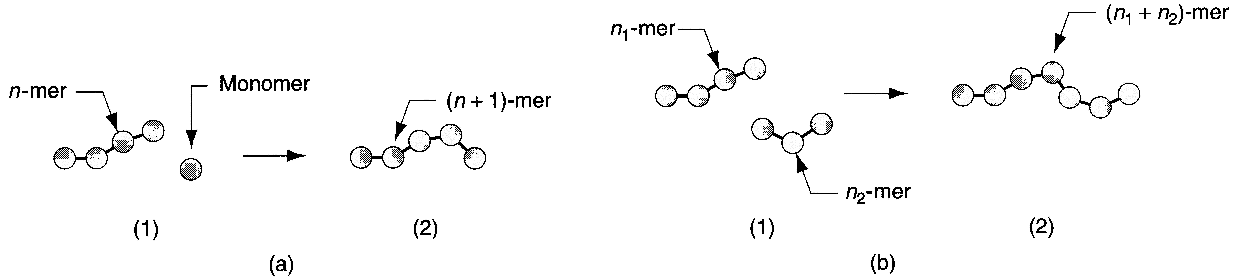
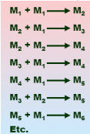
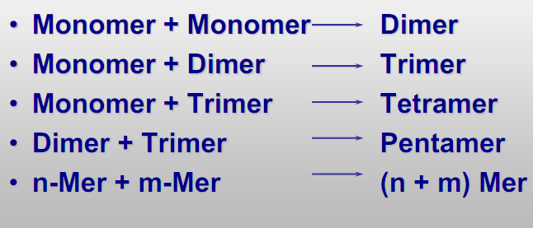

Step Polymerization
Figure - Model of step polymerization showing the two types of reactions occurring: (a) n‑mer attaching a single monomer to form a (n+1)‑mer; and (b) n₁‑mer combining with n₂‑mer to form a (n₁+n₂)‑mer
Sequence is shown by (1) and (2)

Slide 9
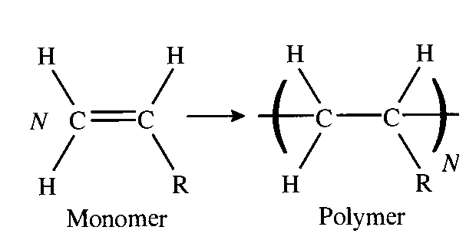
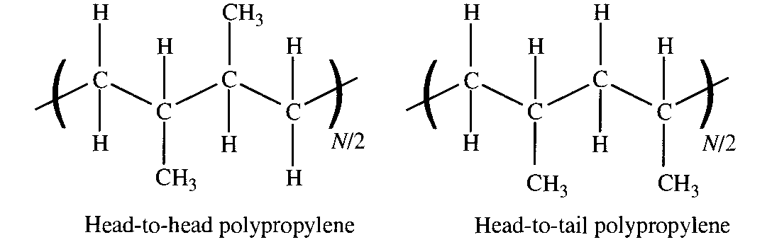
Some Examples
Polymers produced by addition polymerization:
  Polyethylene,
  polypropylene,
  polyvinylchloride,
  polyisoprene
Polymers produced by step polymerization:
  Nylon, polycarbonate, phenol formaldehyde

Slide 10
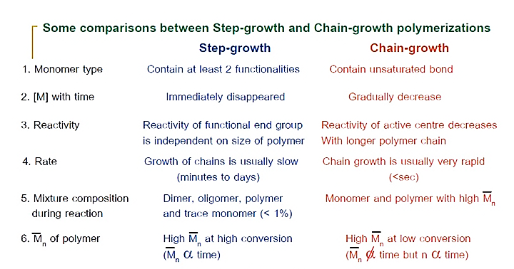
Comparison between step growth and chain growthb polymerization

Slide 11
Degree of Polymerization
Since molecules in a given batch (groups) of polymerized material vary in length, n for the group is an average; its statistical distribution is normal
The mean value of n is called the degree of polymerization (DP) for the group
DP affects on all properties of the polymer:
Higher DP increases mechanical strength but also increases viscosity in the fluid state, which makes processing المعالجة more difficult

Slide 12
Degree of Polymerization

Slide 13
Molecular Weight
The molecular weight (M_{W}) of a polymer is the sum of the molecular weights of the mers in the molecule;
  M_{W} = n times the molecular weight of each repeating unit M_{W} = n M_{i}
  Since n varies for different molecules in a group, the molecule weight must be interpreted as an average

Slide 14
Typical Values M_{W} for Selected Polymers
Polymer Polyethylene Polyvinylchloride Nylon Polycarbonate |  | MW 300,000 100,000 15,000 40,000

Slide 15
Crystallinity in Polymers
Both amorphous and crystalline structures are possible, although the tendency to يميل الى crystallize is much less than for metals or non‑glass ceramics
Not all polymers can form crystals
For those that can, the degree of crystallinity (the proportion of crystallized material in the mass) is always less than 100%

Slide 16
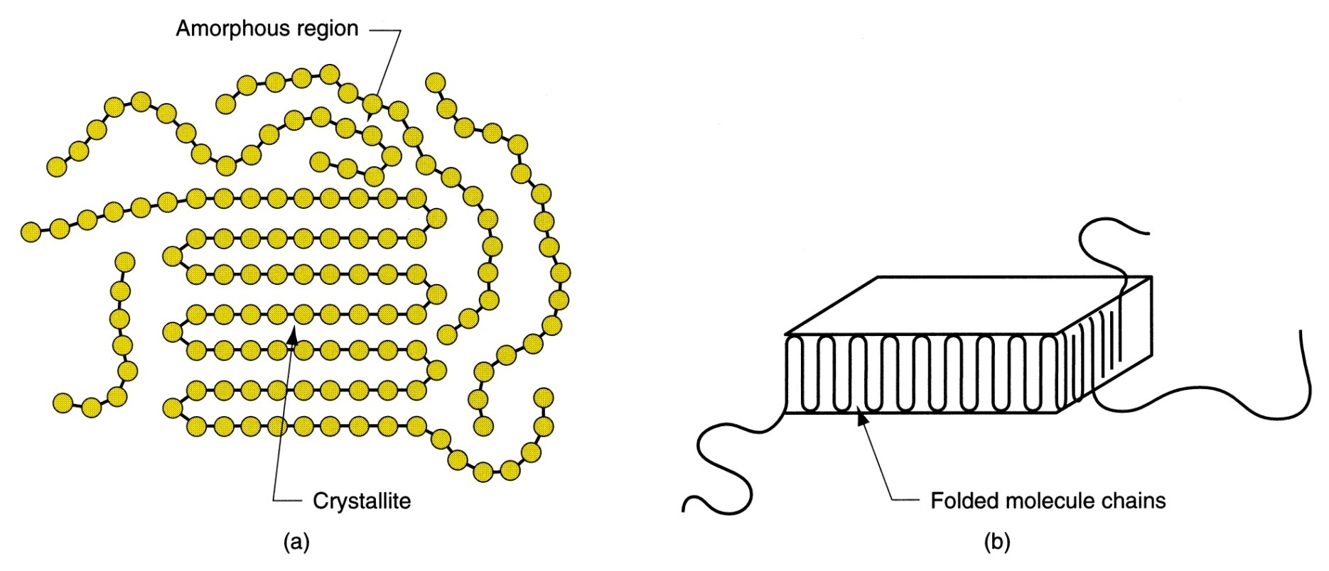
Figure 8.9 ‑ Crystallized regions in a polymer: (a) long molecules forming crystals randomly mixed in with the amorphous material; and (b) folded chain lamella, the typical form of a crystallized region

Slide 17
Crystallinity and Properties
As crystallinity is increased in a polymer:
  Density increases
  Stiffness, strength, and toughness increasesالصلابة وقوة والمتانة
  Heat resistance increases
  If the polymer is transparent in the amorphous state, it becomes opaque when partially crystallized

Slide 18
Some Observations About Crystallization
Linear polymers consist of long molecules with thousands of repeated mers
  Crystallization involves foldingتطوى back and forth of the long chains upon themselves to achieve a very regular arrangement
The crystallized regions are called crystallites
Crystallites take the form of lamellae randomly mixed in with amorphous material
  A polymer that crystallizes is a two‑phase system ‑ crystallites interspersed throughout an amorphous matrix

Slide 19
Factors for Crystallization
Slower cooling promotes crystal formation and growth
Mechanical deformation, as in the stretching of a heated thermoplastic, tends to align the structure and increase crystallization
Plasticizers (chemicals added to a polymer to soften لين it) reduce the degree of crystallinity

Slide 20
Additives
Properties of a polymer can often be changed by combining it with additives
Additives either change the molecular structure or
Add a second phase, in effect transforming the polymer into a composite material

Slide 21
Types of Additives by Function
Fillers – to strengthen polymer or reduce cost
Plasticizers – to soften polymer and improve flow
Colorants – pigments or dyes أصباغ أو ملونات
Lubricants مواد التشحيم – to reduce friction and improve flow
Flame retardents – to reduce flammability of polymer
Cross‑linking agents – for thermosets and elastomers
Ultraviolet light absorbers – to reduce degradationتدهور from sunlight أصباغ أو ملونات
Antioxidants – to reduce oxidation damage المواد المضادة للاكسدة - للحد من ضرر الأكسدة

Slide 22
Guide to the Processing of Polymers
Polymers are nearly always shaped in a heated, highly plastic state
Common operations are extrusion and moldingالعمليات الاكثر شيوعا فى التصنيع هي الصب وقولبة
Molding عمليه الصب of thermosets is more complicated because of cross‑linking
Thermoplastics are easier to mold and a greater variety of molding operations are available
Rubber processing has a longer history than plastics, and rubber industries are traditionally separated from plastics industry, even though processing is similar

